Slide 1
WElcome to the Learning Commons!
Orientation 2020-2021

Slide 2
Complete the Padlet
https://padlet.com/jan_mullis/t11zlswxuq5ykl8k

Slide 3
Take My Reading Interest Survey!
So that I can get to know you more as a reader, please take the survey at the link below.
https://bit.ly/2OOienS

Slide 4
Locating Books in the Learning Commons

Slide 5
Sub-Genres in the Learning Commons
Non-Fiction
Fiction
History & Geography
Science & Math
Social Sciences
Art
Biographies
Literature
More!
Humor (Dark green)
Mystery (Red)
Historical Fiction (Light blue)
Supernatural/Scary (Neon green)
Fantasy (Yellow)
Adventure (Navy blue)
More!

Slide 6
Discover Our Collection Online!
There are 2 ways to access our books online:
Go to the Learning Commons website and click on "Find a Book Here"
Go to Clever.com and select the Destiny Discover icon
Be sure to check out our eBook collection in Destiny as well!

Slide 7
Now...even more options for reading!
Sora by Overdrive

Slide 8
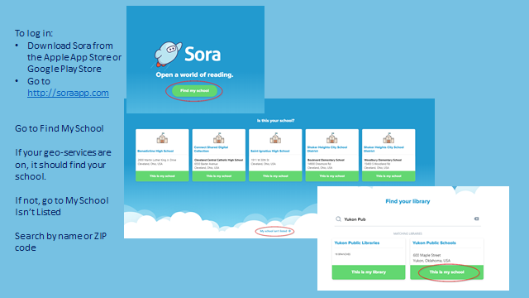

Slide 9
Rules for Checking Out Books
Books are checked out for 2 weeks. Once 2 weeks is up, you will be charged overdue fines!
Keep up with your items and don’t lose them. You will be charged the price of the book if you lose it.
6th graders are limited to 1 book checkout at a time – on a case by case basis ;)
Do not tear pages, get them wet, eat around books, etc.

Slide 10
Need some ideas on what to read next??
Goodreads
Epic Reads
BookRiot
GALILEO NoveList K-8
Find all of these links at the PCMS Learning Commons site!

Slide 11
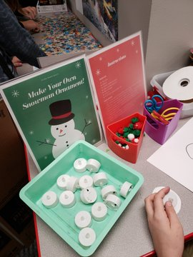
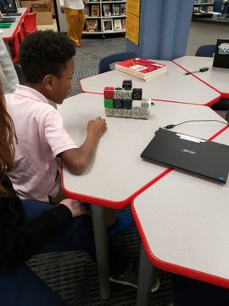
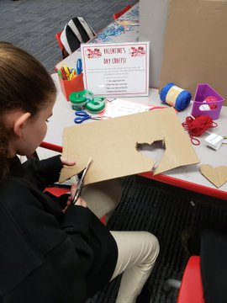
Maker Space: The Place to Be!

Slide 12
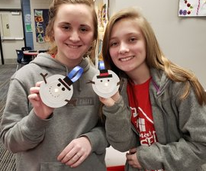
All about the Maker Space
-Must have teacher permission/pass
-Must come with a creative and inquisitive mind.
-Clean up after yourself
-Offer ideas of Maker Space activities to Mrs. Mullis or Mrs. Waller.

